Slide 1
Worm Detection
Network Security and Cryptography
By
Bernard Menezes

Slide 2
Mitigating the Worm Threat
Prevention -This aims to reduce the size of the vulnerable population
Secure programming, applying software updates, AV protection
Patching
Containment- This involves blocking or slowing down the communication between infected and uninfected machines
Suppression- typically a network filter, takes attack source and vector information as input and blocks any traffic from attack sources and filters out network traffic that contains attack vectors
Firewalls, Content Filtering, Automated Routing Blacklists, disconnecting infected machines
Notes:
2

Slide 3
Worm Detection - Challenges
Speed and Accuracy
If patching begins before 5% infection → total infection can be contained to 50%
Non Monomorphic Worms
Zero-day / Zero-hour Worms
So detection looks for characteristics of monomorphic worms.

Slide 4
Worm Detection Clues
Monomorphic Worms have common substrings – fast string matching
Destination port numbers of a worm is single, acc to target application
Scanning techniques used by worms- e.g. Internet Scanning have diverse set if source IP Addresses

Slide 5
Worm Signature Extraction
Worm Signatures are patterns of substrings that occur in payloads of all/most instances of a monomorphic worm
How large should be the common substring
Too small – lot of False Positives
Too large – Lot of False Negatives

Slide 6
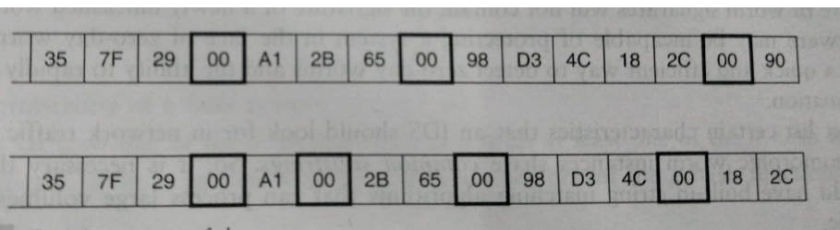
Example
Following two worms are created out of same parent.
Each have superfluous instructions such as NOPs strewn to make it difficult to capture large common substrings

Slide 7
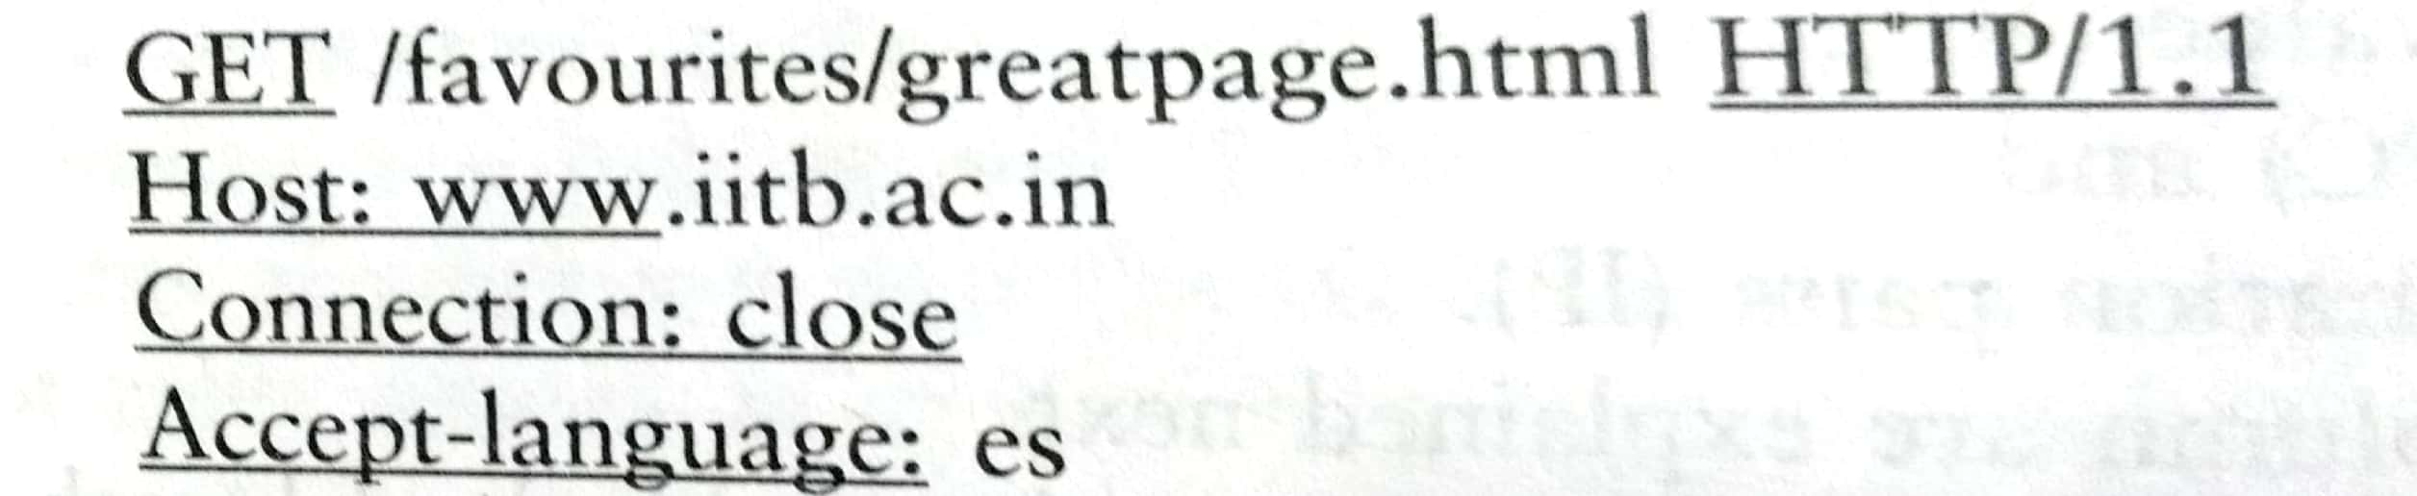
White lists
Commonly occurring strings that are part of protocols – included in white list

Slide 8
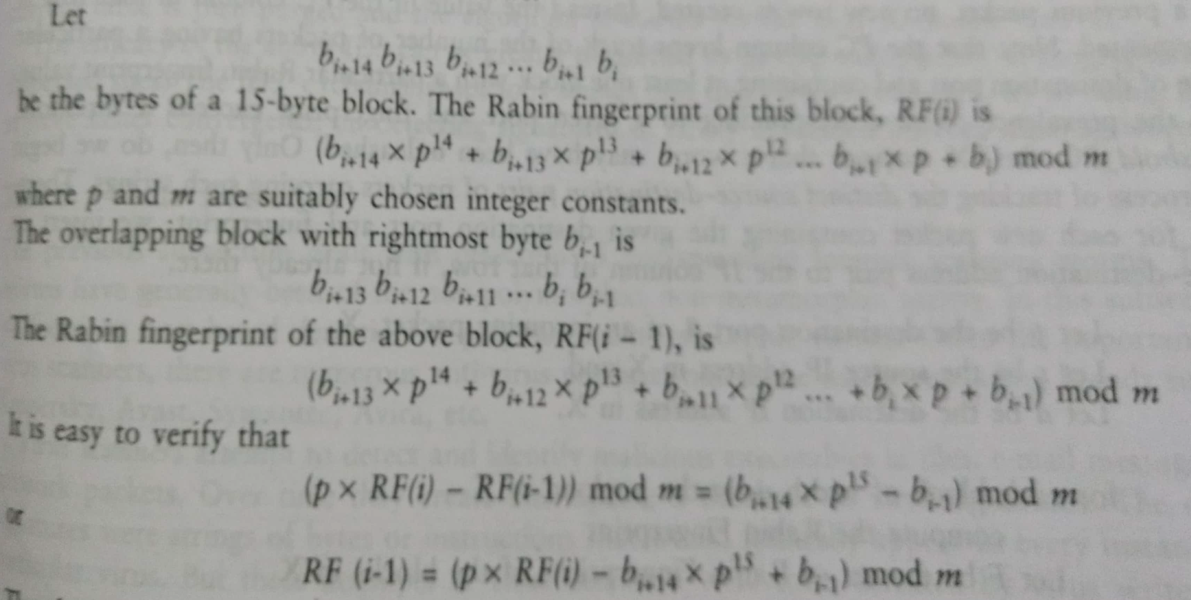
Rabin Fingerprinting(RF) for Worms

Slide 9
Simplified Worm Detection Algorithm
Keep track of suspicious substrings and address dispersion
Create a table, T, with following columns:-
Destination Port No. (Port#)
Rabin Fingerprint Value(RF)
Prevalence Count(PC)
Set of IP source-destination pairs

Slide 10
Outcome of the Algorithm
An Internet Scanning worm is on the prowl
It is targeting a vulnerable application on destination port,p
Its payload contains a Rabin Fingerprint = f
Table may become very large soon
Store only particular fingerprints e.g. ending in 11111
Take highly suspicious to another table for further analysis
Purge the table at regular intervals
Run the algorithm at geographically dispersed systems

Slide 11
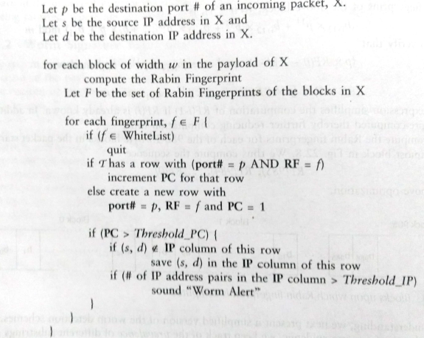
Simplified Worm Detection Algorithm

